Slide 1



MERN – ES6 + React
Module 05: Bootstrap Basics

Slide 2
Outline
Module 05
Bootstrap Basics
Framework concepts
Understanding Inversion of Control
Default Behavior of the Framework
Extensibility nature of Framework
Non-modifiable Framework Code

Slide 3
Outline
Responsive Design
Basic concepts of responsive design
Introduction to responsive design
Viewport
Fluid measurement
Flexbox
Bootstrap 5
Grid System
Typography
Table
Forms
Buttons
Navigation
Layout
RWD templates
Practice

Slide 4
Responsive Web Design
Basic concepts

Slide 5



What is Responsive Web Design?
Responsive design
Responsive web design makes your web page look good on all devices.
Responsive web design uses only HTML and CSS.
Responsive web design is not a program or a JavaScript.
Desktop
Tablet
Phone
Example

Slide 6
What is The Viewport?
Responsive design
The viewport is the user's visible area of a web page.
The viewport varies with the device, and will be smaller on a mobile phone than on a computer screen.
Setting The Viewport:
<meta name="viewport" content="width=device-width, initial-scale=1.0">
The width=device-width part sets the width of the page to follow the screen-width of the device (which will vary depending on the device).
The initial-scale=1.0 part sets the initial zoom level when the page is first loaded by the browser.

Slide 7
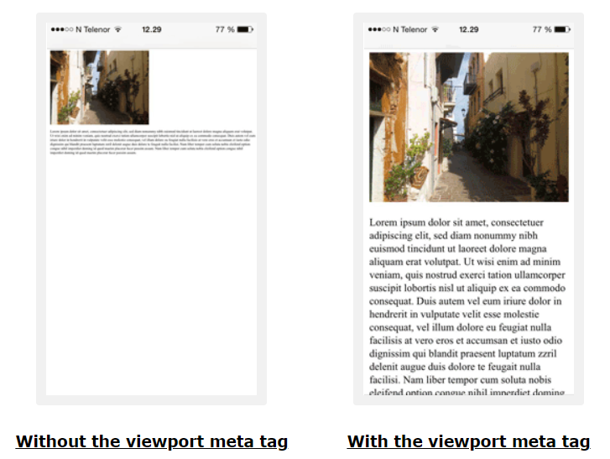
What is The Viewport?
Responsive design

Slide 8
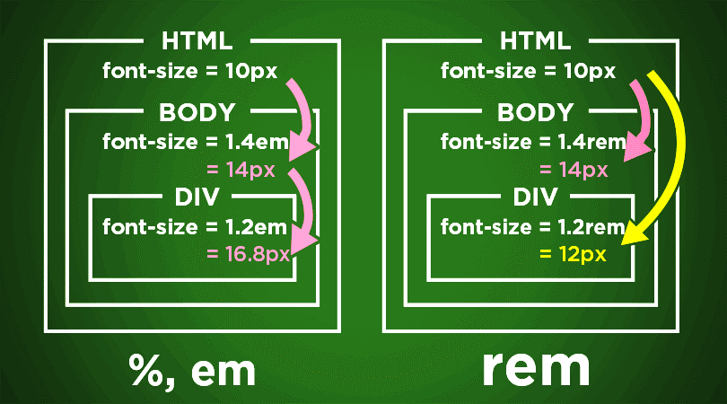
Fluid measurements
Responsive design
%
percentage values are always relative to another value, for example a length
em
font size of the element
Rem
font size of the root element
vw
viewport’s width, 1/100th of the width of the viewport.
vh
viewport’s height, 1/100th of the height of the viewport.
1em = 12pt = 16px = 100%
1in = 2.54cm = 25.4mm = 72pt = 12pc

Slide 9
Flexbox
Flex Container
Flex Items
Flex Layout

Slide 10
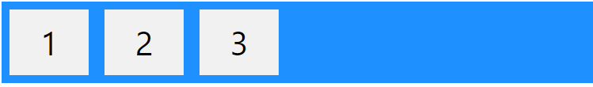
Flexbox
Flex Container + Flex Items
The flex container becomes flexible by setting the display property to flex:
Flex container properties
Flex Item properties
flex-direction
flex-wrap
flex-flow
justify-content
align-items
align-content
order
flex-grow
flex-shrink
flex-basis
flex
align-self

Slide 11
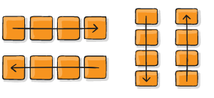
Flexbox
Flex container properties
Flex container properties
flex-direction
flex-wrap
flex-flow
justify-content
align-items
align-content
.container {
flex-direction: row | row-reverse | column | column-reverse;
}

Slide 12
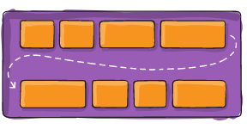
Flexbox
Flex container properties
Flex container properties
flex-direction
flex-wrap
flex-flow
justify-content
align-items
align-content
.container {
flex-wrap: nowrap | wrap | wrap-reverse;
}

Slide 13
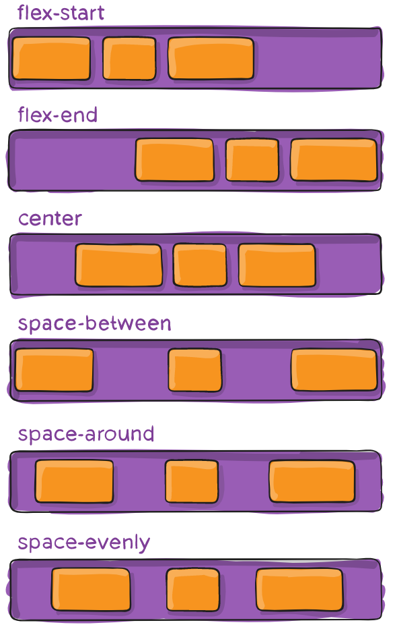
Flexbox
Flex container properties
Flex container properties
flex-direction
flex-wrap
flex-flow
justify-content
align-items
align-content
.container {
justify-content: flex-start | flex-end | center | space-between | space-around | space-evenly | start | end | left | right;
}

Slide 14
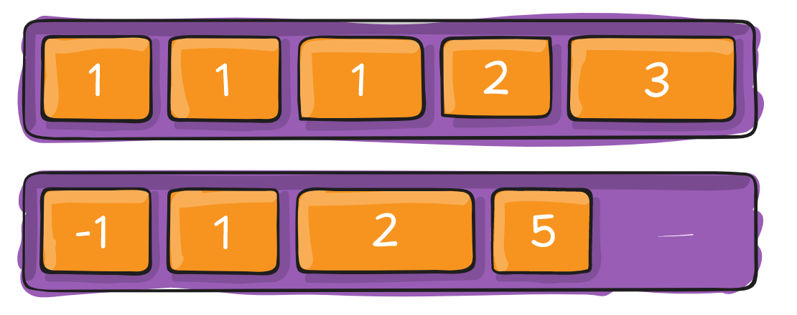
Flexbox
Flex container properties
Flex Item properties
order
flex-grow
flex-shrink
flex-basis
flex
align-self

Slide 15
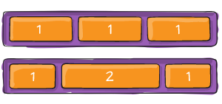
Flexbox
Flex container properties
Flex Item properties
order
flex-grow
flex-shrink
flex-basis
flex
align-self

Slide 16
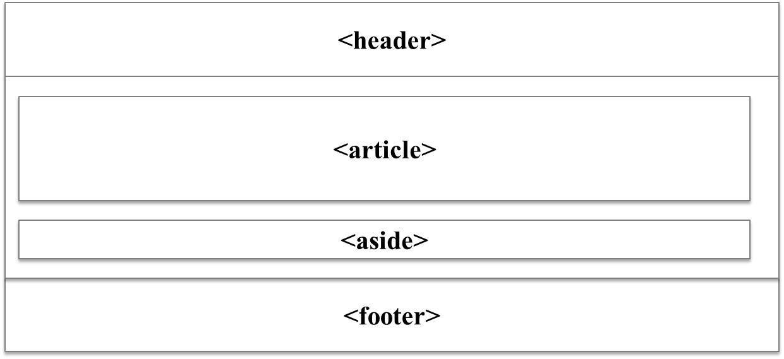
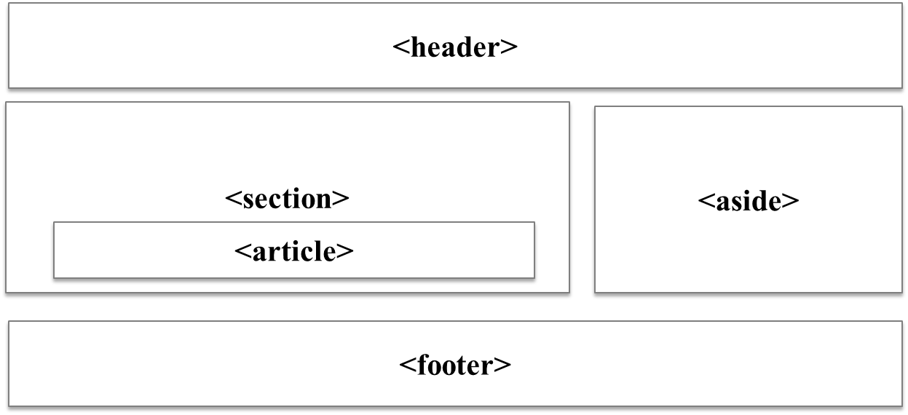
Wireframes
Wireframes provide a visual representation of your layout.
What goes where?
What content (including graphical) do you NEED to have on the page?
What is the best layout for this material?
Mobile view
Larger View
http://www.wireframeshowcase.com/

Slide 17

Bootstrap 5
Most popular front-end framework

Slide 18
Frameworks
What is a framework?
The term “web framework” can mean many things, it depends upon who you ask.
Agreement, a framework should make your job easier by providing code and structure.
Front-end developers
HTML,CSS, JavaScript
Back-end developers
Routing, resources, security
Popular front-end frameworks
Bootstrap (2011)
Foundation by ZURB (2011)
Semantic UI (2013)
Pure by Yahoo! (2013)
Ulkit by YOOtheme(2013)

Slide 19
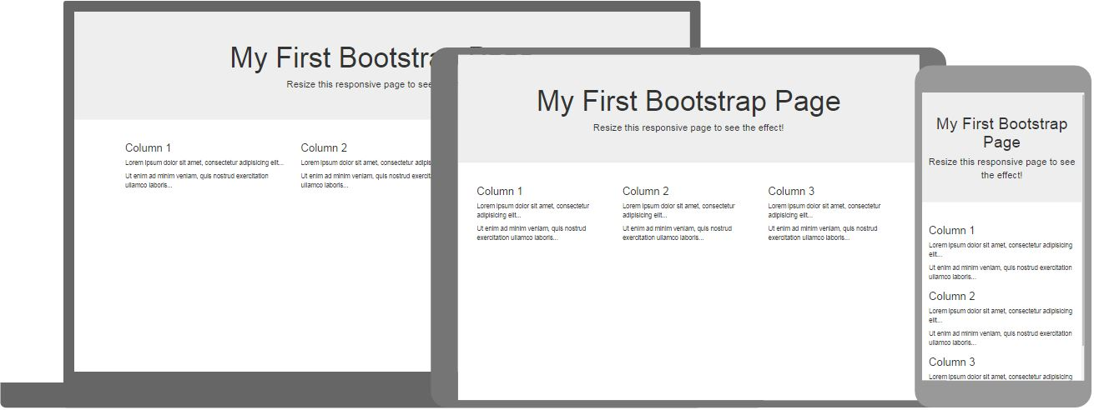
Bootstrap 5
Responsive web design
Bootstrap 5 is the newest version of Bootstrap, which is the most popular HTML, CSS, and JavaScript (front-end) framework for creating responsive, mobile-first websites.
Bootstrap includes HTML and CSS based design templates (components) for typography, forms, buttons, tables, navigation, modals, image carousels and many other, as well as optional JavaScript plugins
Bootstrap also gives you the ability to easily create responsive designs
The main differences between Bootstrap 5 and Bootstrap 3 & 4, is that Bootstrap 5 has switched to JavaScript instead of jQuery.
Bootstrap 5 is completely free to download and use!

Slide 20
Where to Get Bootstrap 5?
Responsive web design
There are two ways to start using Bootstrap 5 on your own web site.
Include Bootstrap 5 from a CDN (jsDelivr - Content Delivery Network)
Download Bootstrap 5 from getbootstrap.com
<!-- Latest compiled and minified CSS --> <link href="https://cdn.jsdelivr.net/npm/bootstrap@5.1.3/dist/css/bootstrap.min.css" rel="stylesheet"> <!-- Latest compiled JavaScript --> <script src="https://cdn.jsdelivr.net/npm/bootstrap@5.1.3/dist/js/bootstrap.bundle.min.js"></script>

Slide 21
Create Your First Web Page With Bootstrap 5
Responsive web design
<!DOCTYPE html> <html lang="en"> <head> <title>Bootstrap Example</title> <meta charset="utf-8"> <meta name="viewport" content="width=device-width, initial-scale=1"> <link href="https://cdn.jsdelivr.net/npm/bootstrap@5.1.3/dist/css/bootstrap.min.css" rel="stylesheet"> <script src="https://cdn.jsdelivr.net/npm/bootstrap@5.1.3/dist/js/bootstrap.bundle.min.js"></script> </head> <body> <div class="container"> <h1>My First Bootstrap Page</h1> <p>This part is inside a .container class.</p> <p>The .container class provides a responsive fixed width container.</p> </div> </body> </html>
1. Add the HTML5 doctype
2. Bootstrap 5 is mobile-first
3. Containers

Slide 22
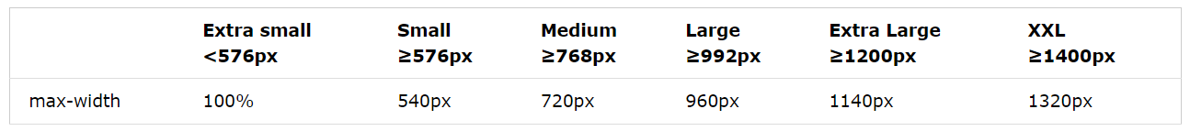
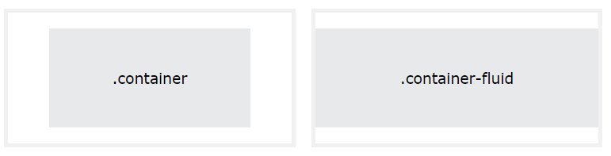
Bootstrap 5 Containers
Responsive web design
Containers are used to pad the content inside of them, and there are two container classes available:
The .container class provides a responsive fixed width container
The .container-fluid class provides a full width container, spanning the entire width of the viewport

Slide 23
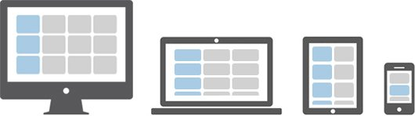
Bootstrap 5 Grid System
Responsive web design
Bootstrap's grid system is built with flexbox and allows up to 12 columns across the page.
If you do not want to use all 12 columns individually, you can group the columns together to create wider columns:
3 columns = 25%
6 columns = 50%
9 columns = 75%
12 columns = 100%

Slide 24
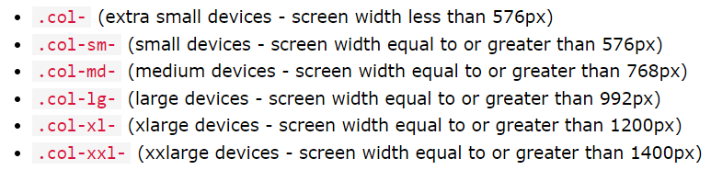
Grid classes
Bootstrap 5 Grid System
Every grid consists of:
A container
A row
One or more column classes
<div class= “container”>
<div class= “row”>
<div class= “col-xx-yy”>
The “xx” component is the viewport size: xs, sm, md, lg
The “yy” component is the number of columns: 0..12
<img src = “pic.jpg” class=“col-xs-12 col-sm-6 col-md-3 col-lg-2”>
Notes:
Tip: Each class scales up, so if you want to set the same widths for sm and md, you only need to specify sm.

Slide 25
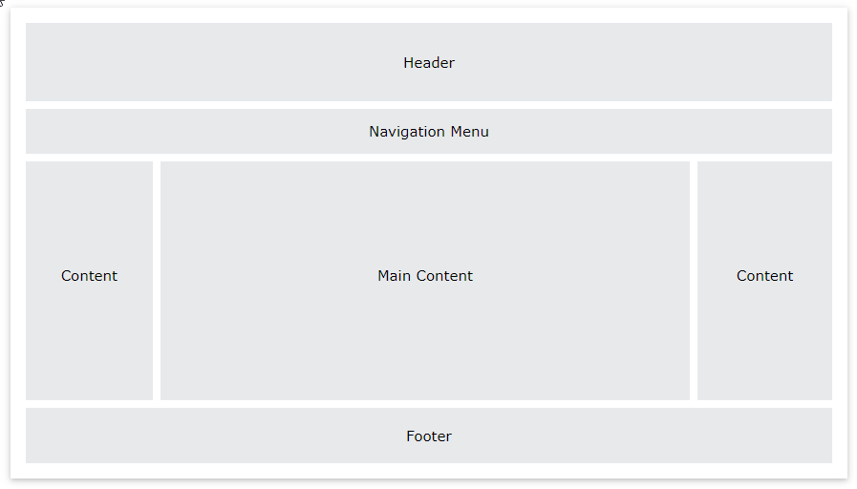
Bootstrap 5 Grid System
Layout design Challenge

Slide 26
Summary
Module 05
Bootstrap Basics
Framework concepts
Understanding Inversion of Control
Default Behavior of the Framework
Extensibility nature of Framework
Non-modifiable Framework Code

